Slide 1
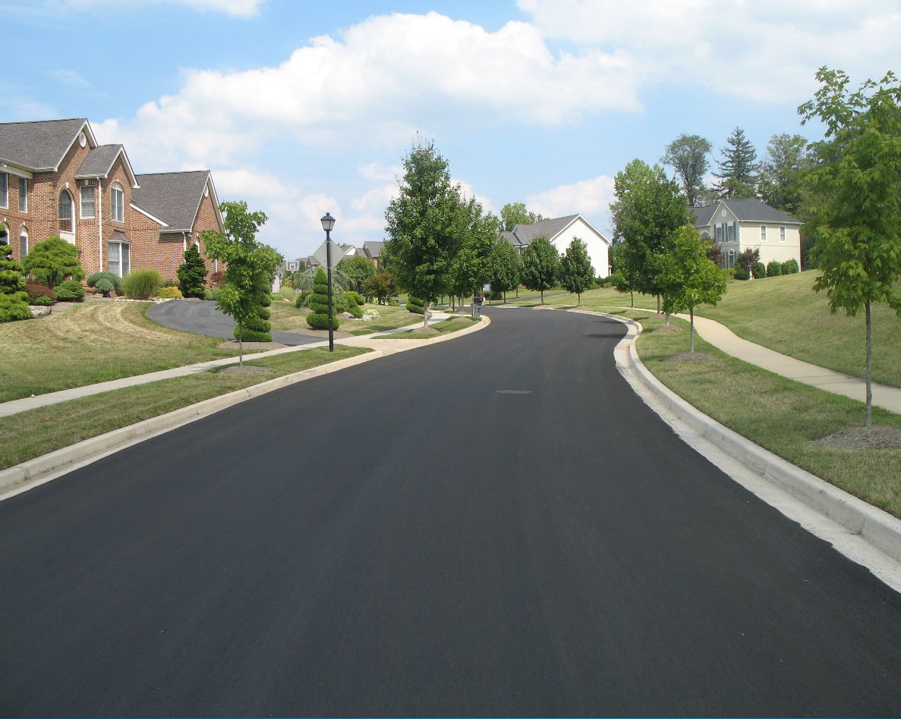
Micro Surfacing In Your Neighborhood

Slide 2
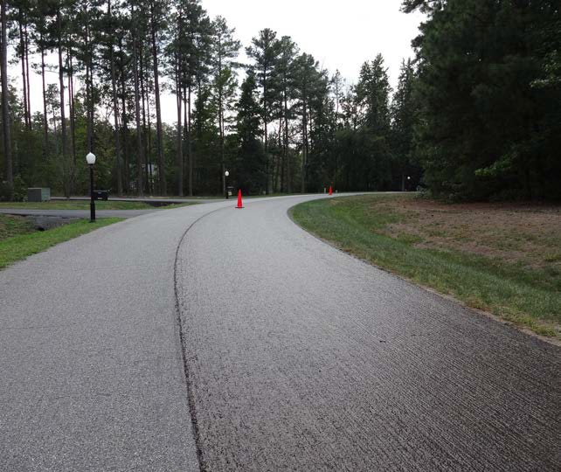
Part of a family of asphalt maintenance treatments used worldwide since
the 1930’s
Slurry surfacing systems used in the US since the 60’s
Slurry Pavers has been applying them for more than 50 years

Slide 3
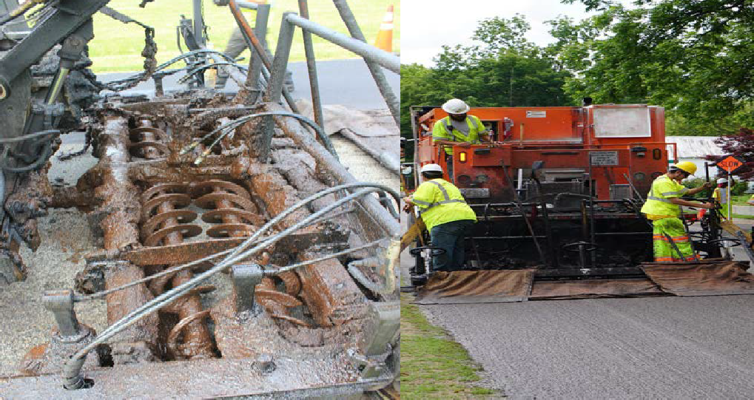
Blend of emulsified asphalt, fine aggregate, mineral filler, water and latex polymers
Mixed and spread in a mobile operation as thin wearing surface
Extends the life of pavement in upwards of 8 years or longer.

Slide 4
Micro Surfacing vs. traditional asphalt resurfacing

Slide 5
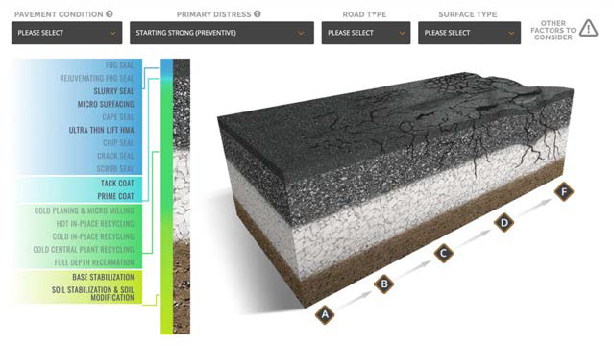
Courtesy of roadresource.org
PCI Rating Scale
A = 85-100
B = 70-84
C = 55-69
D = 40-54
F = 0-39

Slide 6
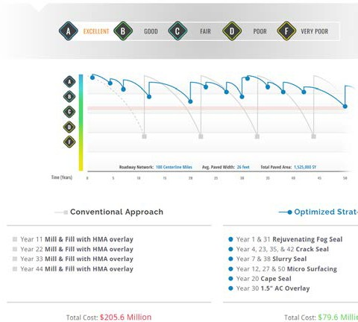

Slide 8
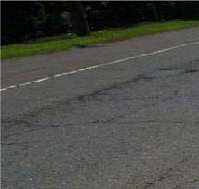
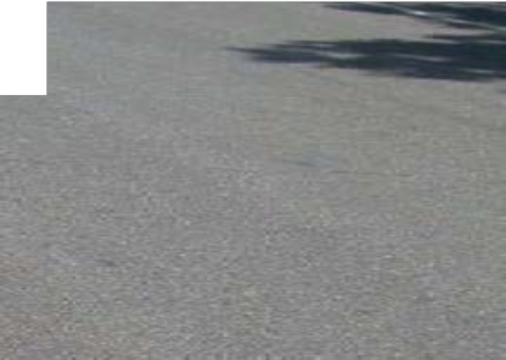
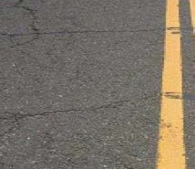
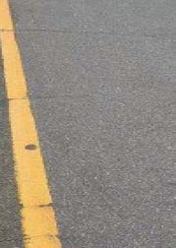
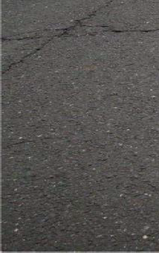
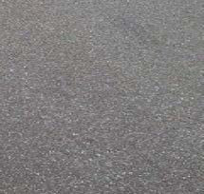
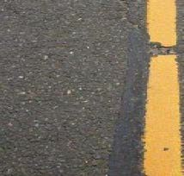
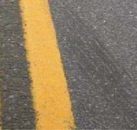
A Tale of Two Townships

Slide 9
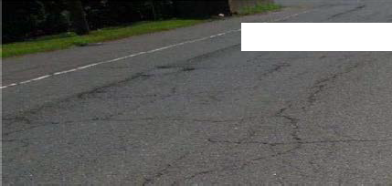
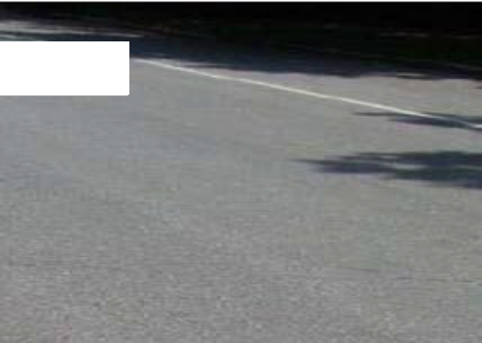
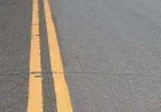
2004 Mill and Fill 2.5” Hot Mix Asphalt

Slide 10
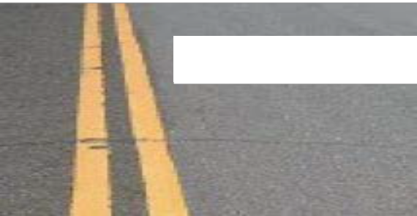
2004 Mill and Fill 2.5” Hot Mix Asphalt
2010 Crack Fill and Micro Surfacing
Photo taken in 2014

Slide 13
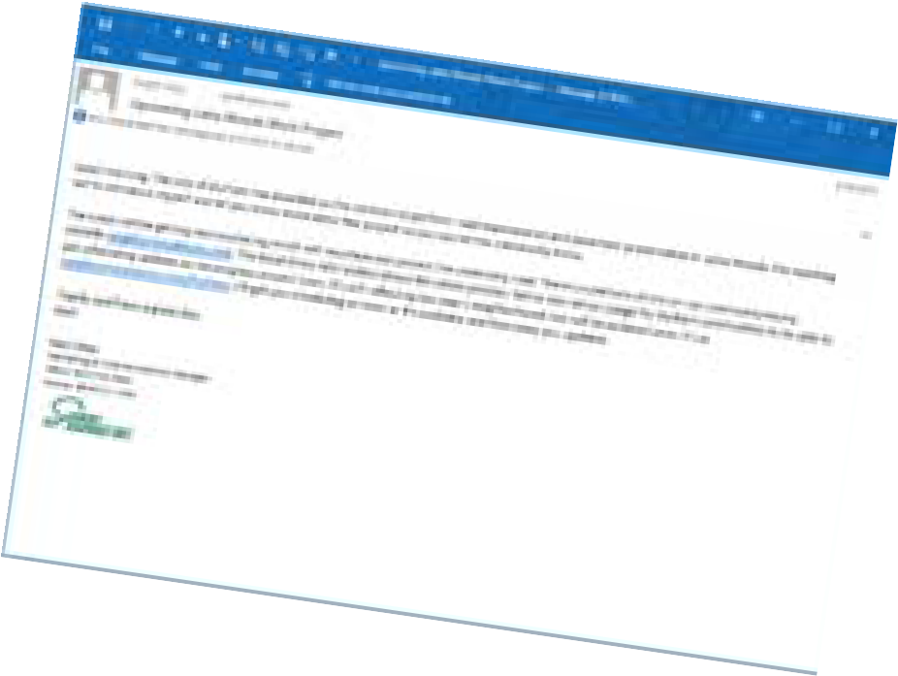
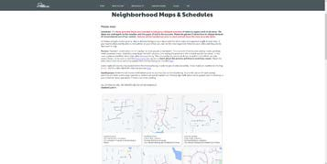
Project Notification mailed well in advance of all work commencing
Signs and Notices several days before slurry application begins
No Parking signs posted in advance
Community groups and website updated throughout the project

Slide 14
Crack Sealing
Cracks 1/4 inch and greater filled
Quick-moving operation, parking affected need-only
Work zone protected by flaggers
Generally unintrusive

Slide 15
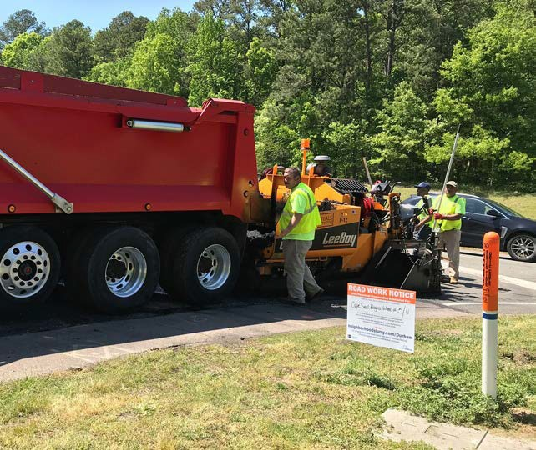
Patching
Localized failures repaired with plant mix asphalt
Includes potholes, utility cuts, wide cracks, minor “alligatoring”
Localized parking restrictions

Slide 16
Micro Surfacing
On the day work begins Traffic Control crew arrives
Cones put out, manhole and utility covers protected
TIP: Work will be performed today.

Slide 17
Micro Surfacing
Some intersections taped off
Roadway swept prior to resurfacing

Slide 18
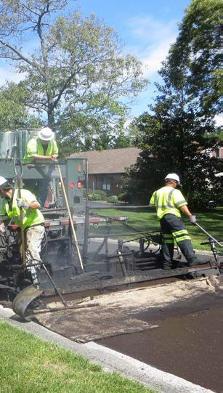
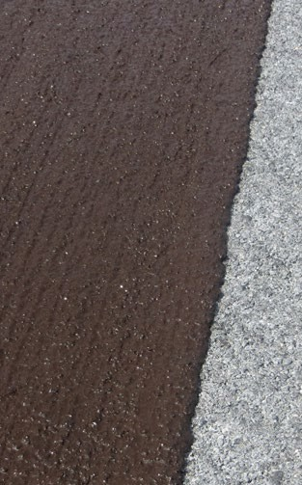
Micro Surfacing
Brown when initially placed
Water evaporates and surface turns black
Coned off, flaggers
Traffic-ready in 1 to 2 hours
TIP: Do not cross brown Micro Surfacing

Slide 19
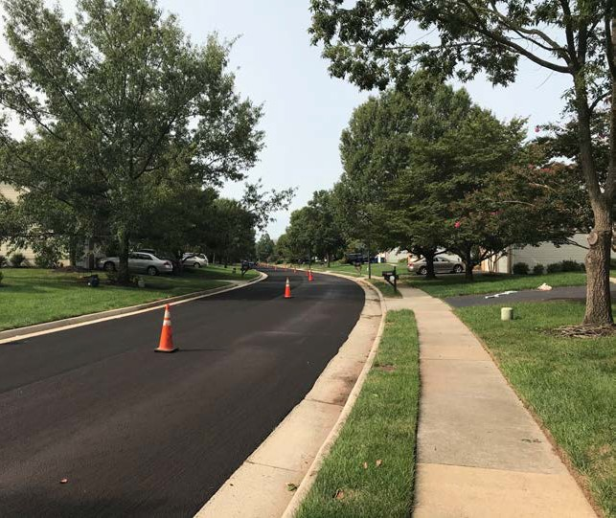
Micro surfacing
Lanes will be clearly defined by traffic cones
When in doubt, the darker lane will be the travel lane
Drive conservatively

Slide 20
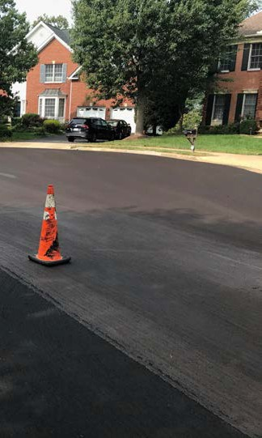
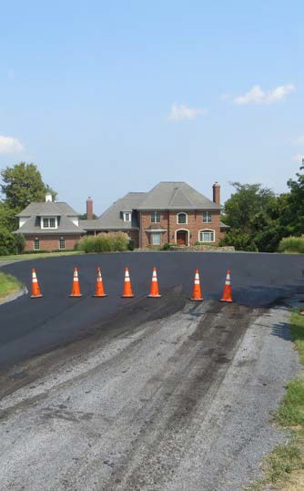
Micro Surfacing
Some cul-de-sacs may need to be done all at once
Residents in the circle will be notified to make arrangements to move vehicles if necessary
TIP: Crew will notify residents if so

Slide 21
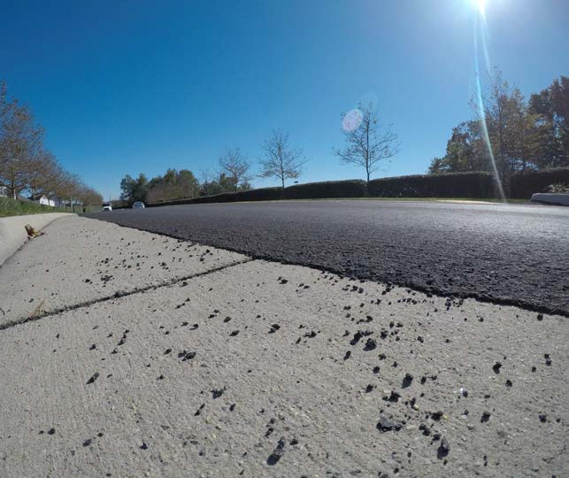
Surface "fines" ravel off during wear-in and curing
Streets are swept about two weeks after treatment, sanding swept earlier
Monitored for several weeks and then inspected to ensure everything is complete

Slide 22
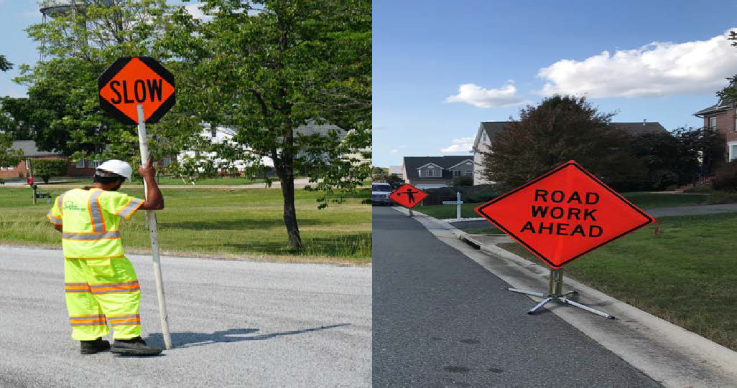
Cooperation is Key!
Please follow direction from traffic control
Pay attention to road signs

Slide 23
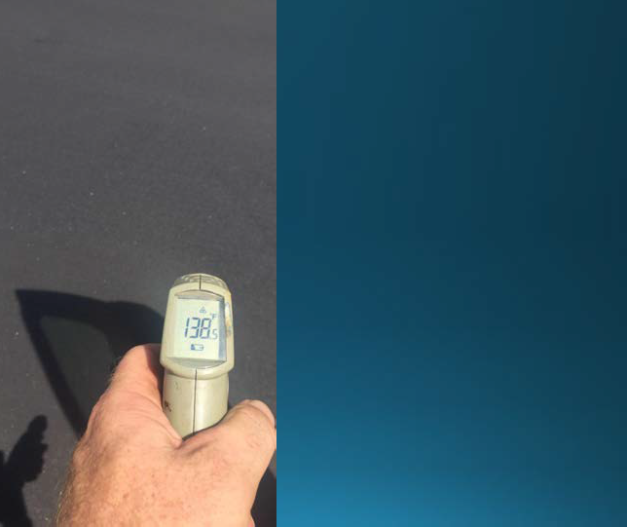
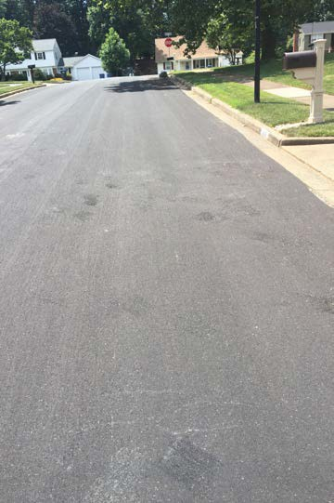
New Asphalt surfaces can scuff
High surface temps soften every type of new asphalt
Drive conservatively and avoid sitting still while turning wheel
Most will blend in with time and traffic

Slide 24
Micro Surface or Hot Mix Asphalt?

Slide 25
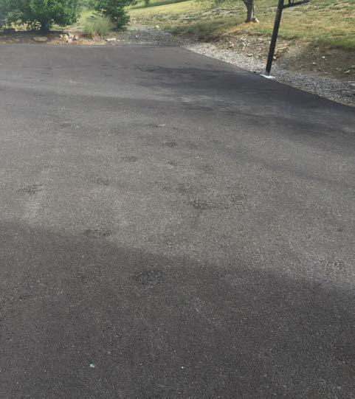
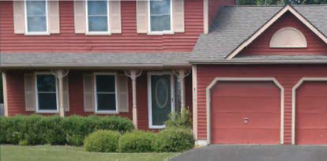
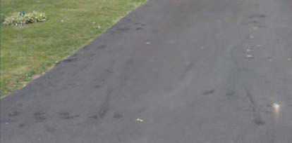
Homeowners' New Hot Mix Asphalt and Asphalt Pavement Sealer

Slide 26
www.neighborhoodslurry.com

Slide 27
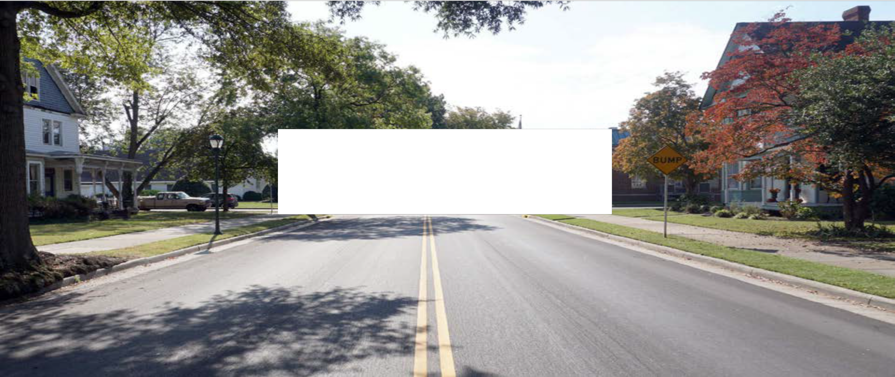
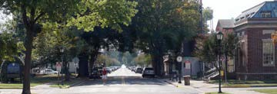
Thank you.

